Slide 1
templates

Slide 2

1. What’s the current traffic data situation?
Current traffic situation
Current Google data issues
Missing
Incorrect
Data types
Events
Pages

Slide 3
2. Why should we tackle traffic data issues?
Why is it important to tackle the issues upcoming from the current situation?
Improve
processes
Events impossible to analyze
Wrong analysis’ conclusions
Communication
Implementation
Maintenance
Analysis
Missing data
Incorrect data

Slide 4
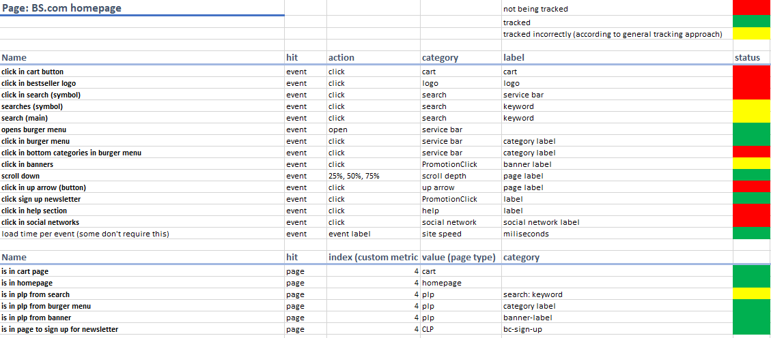
3. How?
How can we change current status?
Example:
Document existing processes
Create & document non-existing processes

Slide 5
4. Future?
Better, more detailed and trustful source of data
How would the future situation look like
Small investment
Big gains
Future
More and better data
Knowledge + Trust = Easier and faster decision making
Maximize performance of “main” product - website

Slide 6
4. Future?
Better, more detailed and trustful source of data
Practical examples
Burger menu
Site performance
My account
Loading times
Search engine
Notify me
Customer Journey
Banners
New KPIs, events or site componens
Newsletter

